Slide 1

Customer Prediction Dashboard

Slide 2
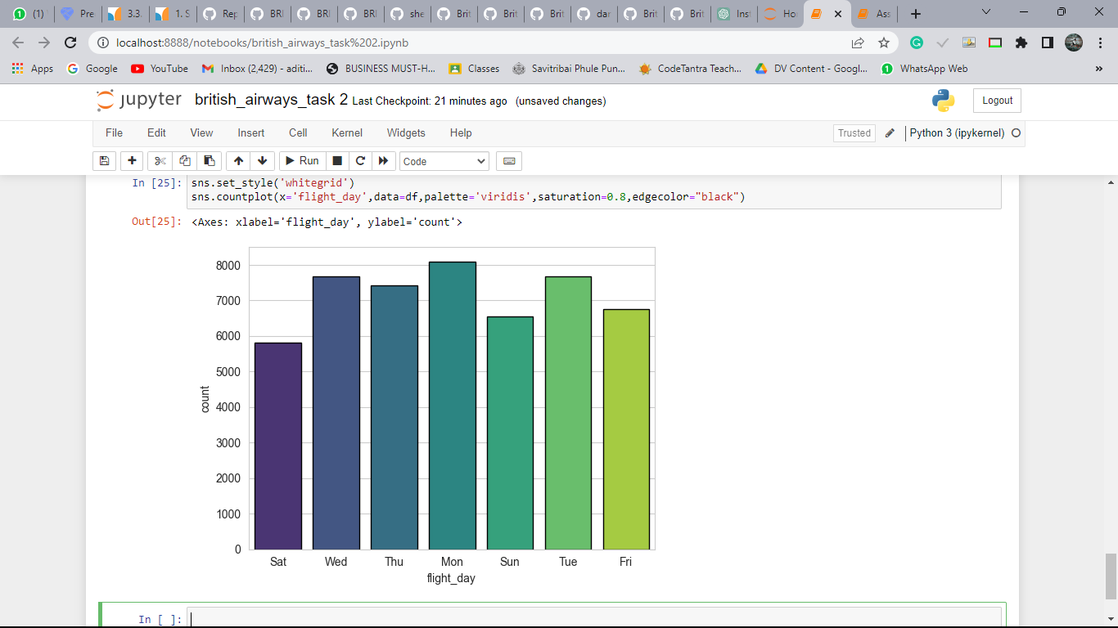
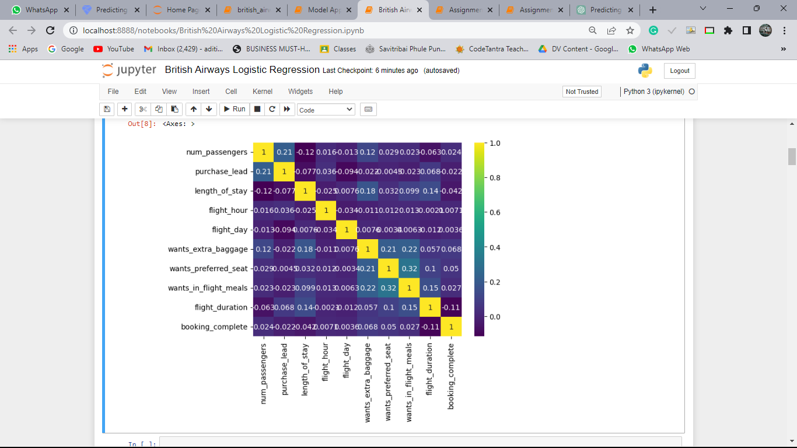
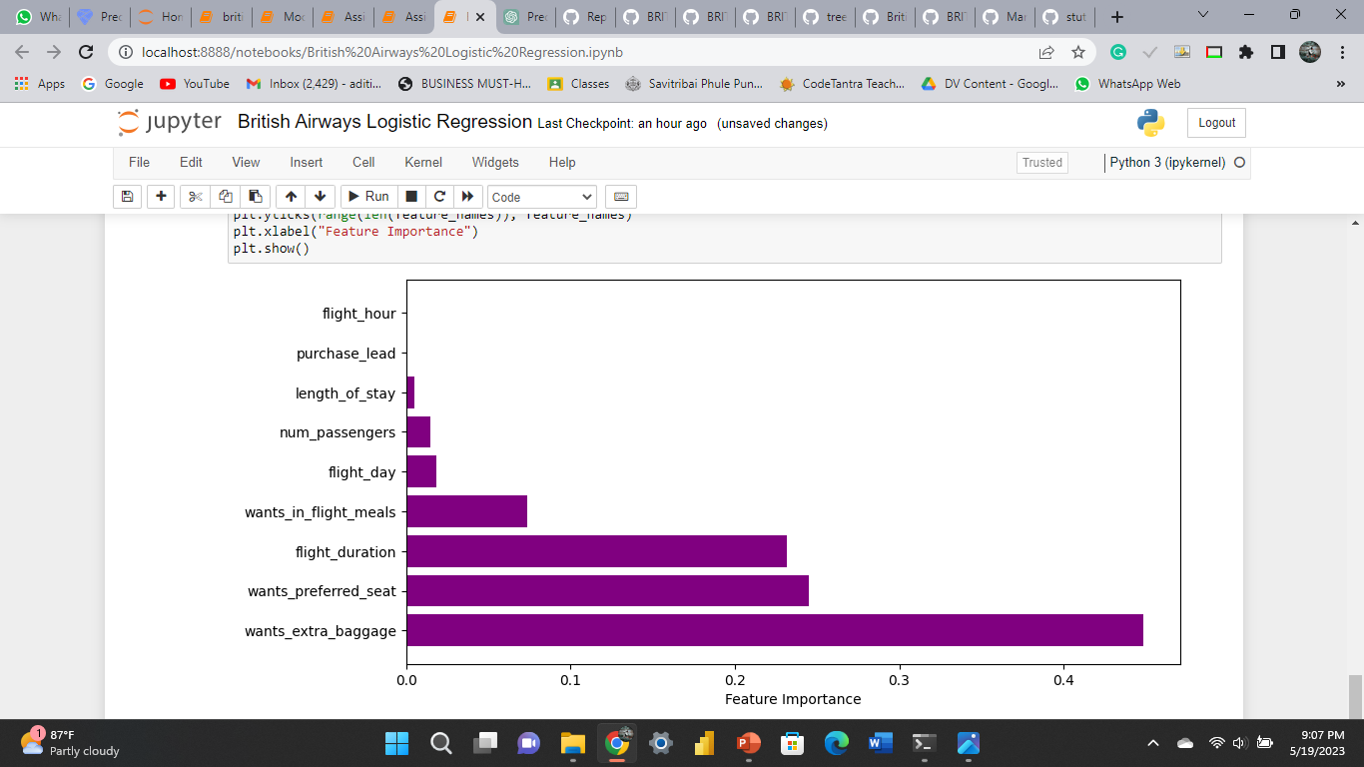
Customer Prediction Dashboard
Logistic Regression
Accuracy
85.2%
Predicting successful or incomplete booking is
Precision
72.59%
Feature Importance
Logistic regression
Actually completed bookings out of all successfully completed bookings.
Recall
85.2%
Chance of predicting true successful bookings.

